Slide 1
Geometric Model of Camera
Dr. Chang Shu
COMP 4900C
Winter 2008

Slide 2
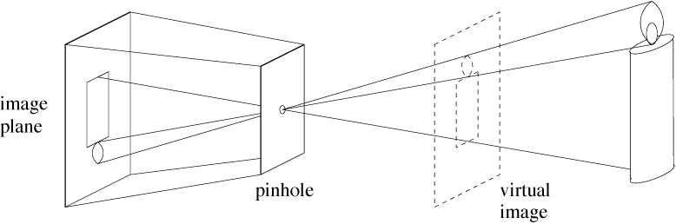
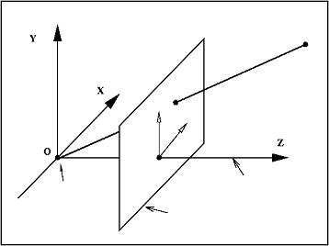
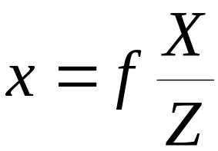
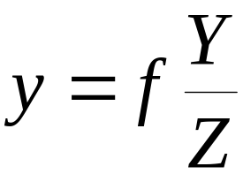
Geometric Model of Camera
Perspective projection
P
P(X,Y,Z)
p(x,y)
p
y
x
principal
point
principal
axis
optical
center
image
plane

Slide 3

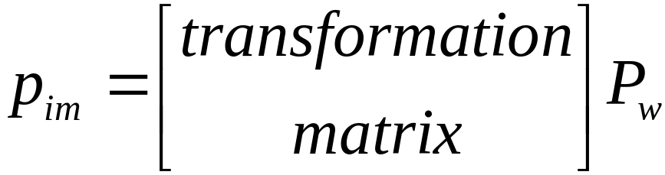
Four Coordinate Frames
Pw
pixel
frame
xim
Zw
Yw
yim
Yc
y
Xc
Xw
camera
frame
world
frame
Zc
image
plane
frame
x
optical
center
principal
point
Camera model:

Slide 4






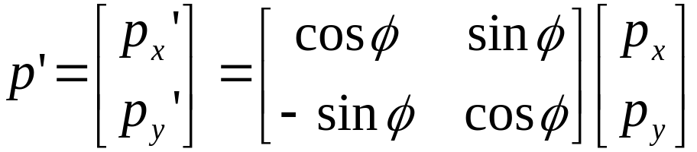
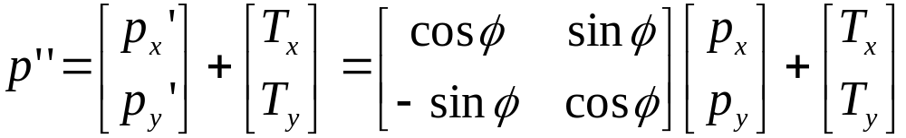
Coordinate Transformation – 2D
P
Rotation and Translation
T
φ

Slide 5
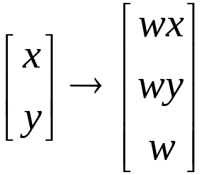
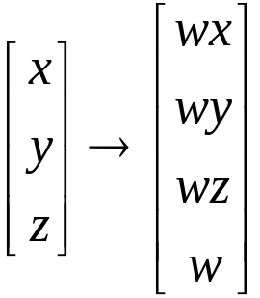

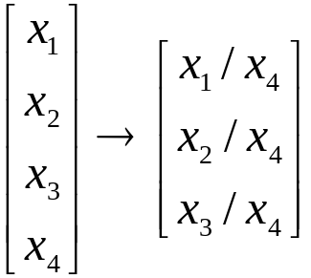
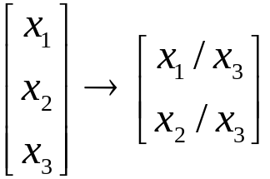
Homogeneous Coordinates
Go one dimensional higher:
is an arbitrary non-zero scalar, usually we choose 1.
From homogeneous coordinates to Cartesian coordinates:

Slide 6
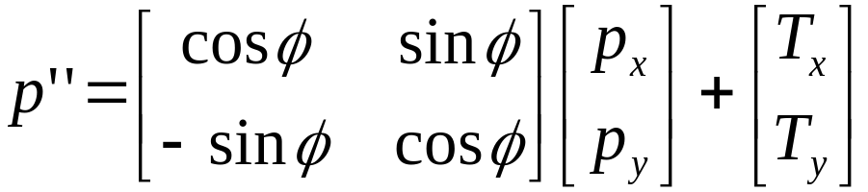
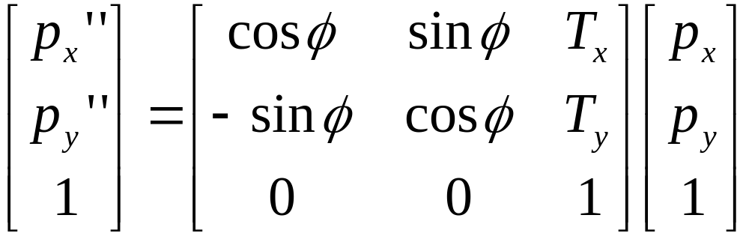
2D Transformation with Homogeneous Coordinates
2D coordinate transformation:
2D coordinate transformation using homogeneous coordinates:

Slide 7
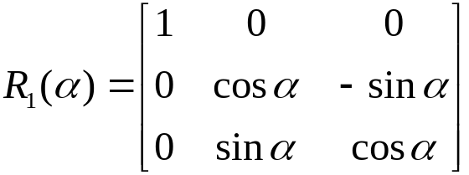
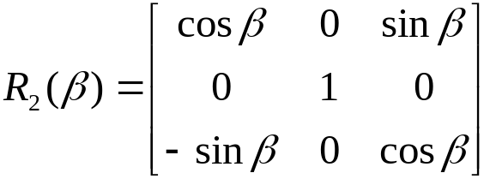
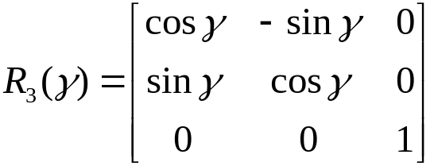

3D Rotation Matrix
Rotate around each coordinate axis:
Combine the three rotations:
3D rotation matrix has three parameters.

Slide 8
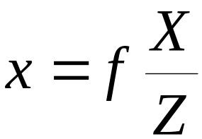
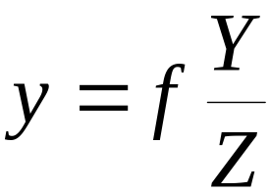
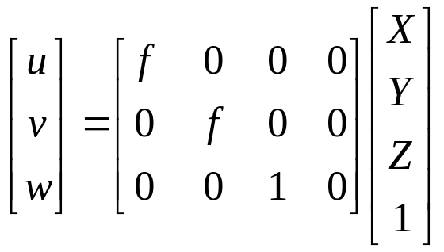


Perspective Projection
P
p
y
x
These are nonlinear.
principal
point
principal
axis
optical
center
image
plane
Using homogenous coordinate, we have a linear relation:

Slide 9

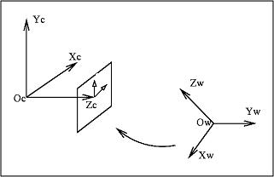
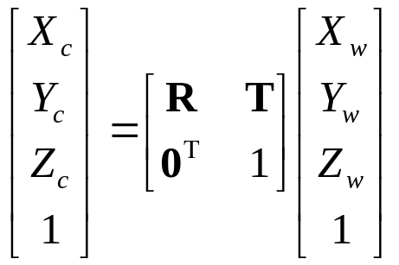
World to Camera Coordinate
Transformation between the camera and world coordinates:
R,T

Slide 10



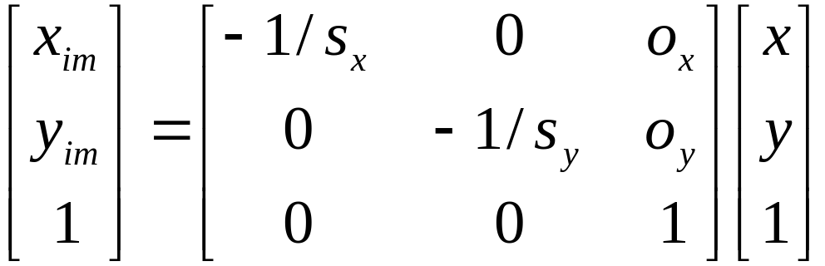
Image Coordinates to Pixel Coordinates
pixel sizes
xim
yim
y
x
(ox,oy)

Slide 11
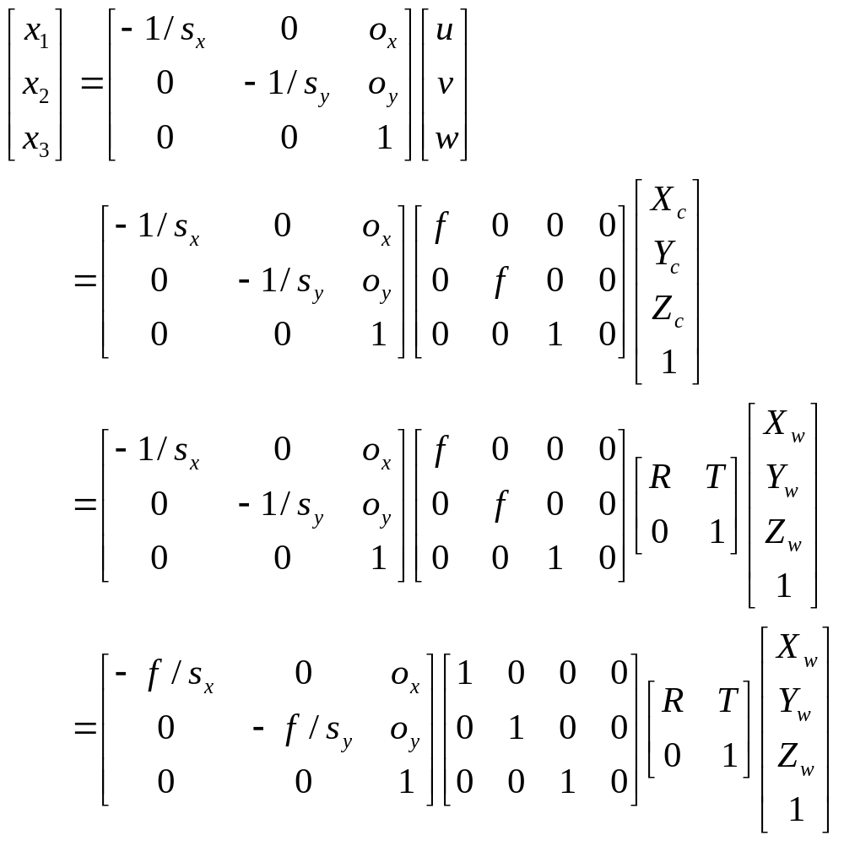
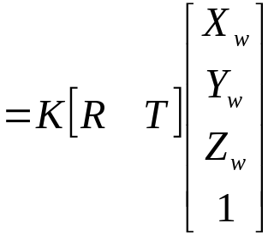


Put All Together – World to Pixel

Slide 12
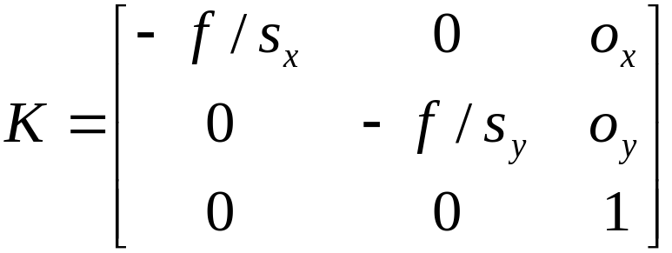


Camera Intrinsic Parameters
K is a 3x3 upper triangular matrix, called the
Camera Calibration Matrix.
There are five intrinsic parameters:
The pixel sizes in x and y directions
The focal length
The principal point (ox,oy), which is the point
where the optic axis intersects the image plane.

Slide 13
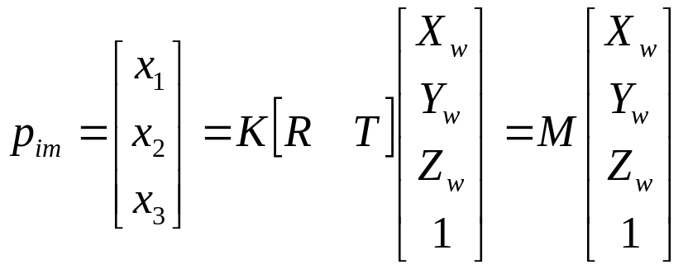
Extrinsic Parameters
[R|T] defines the extrinsic parameters.
The 3x4 matrix M = K[R|T] is called the projection matrix.

Slide 14

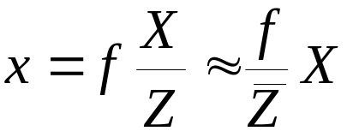
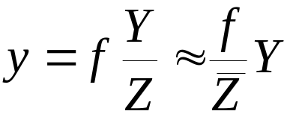
Weak Perspective Model
If the relative distance between any two points along the
principal axis is much smaller than the average distance
The camera projection can be approximated as:
This is the weak-perspective camera model.

Slide 15
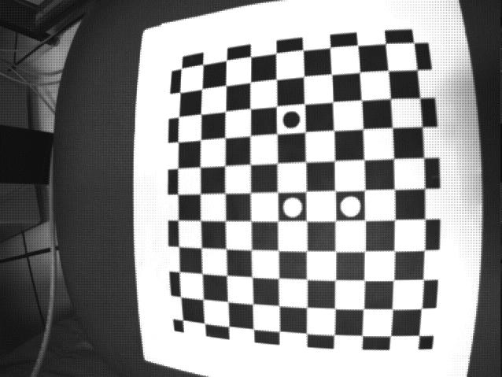
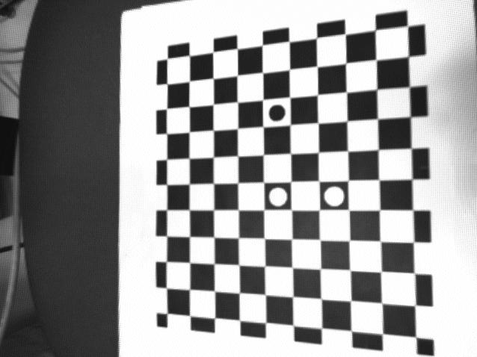
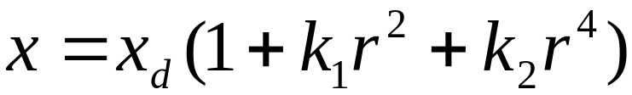
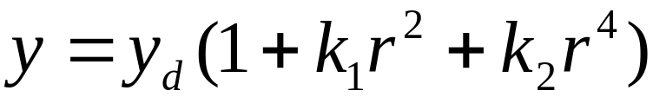

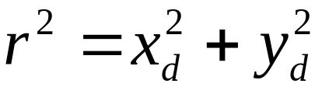
Radial Distortions
are the coordinates of the distorted points, and

